Slide 2

Ypp 4
bbv Software Services AG | Date

Slide 3
Agenda
Google Drive functions and database design as follow
Fulltext Search with BM25
Q&A

Slide 4
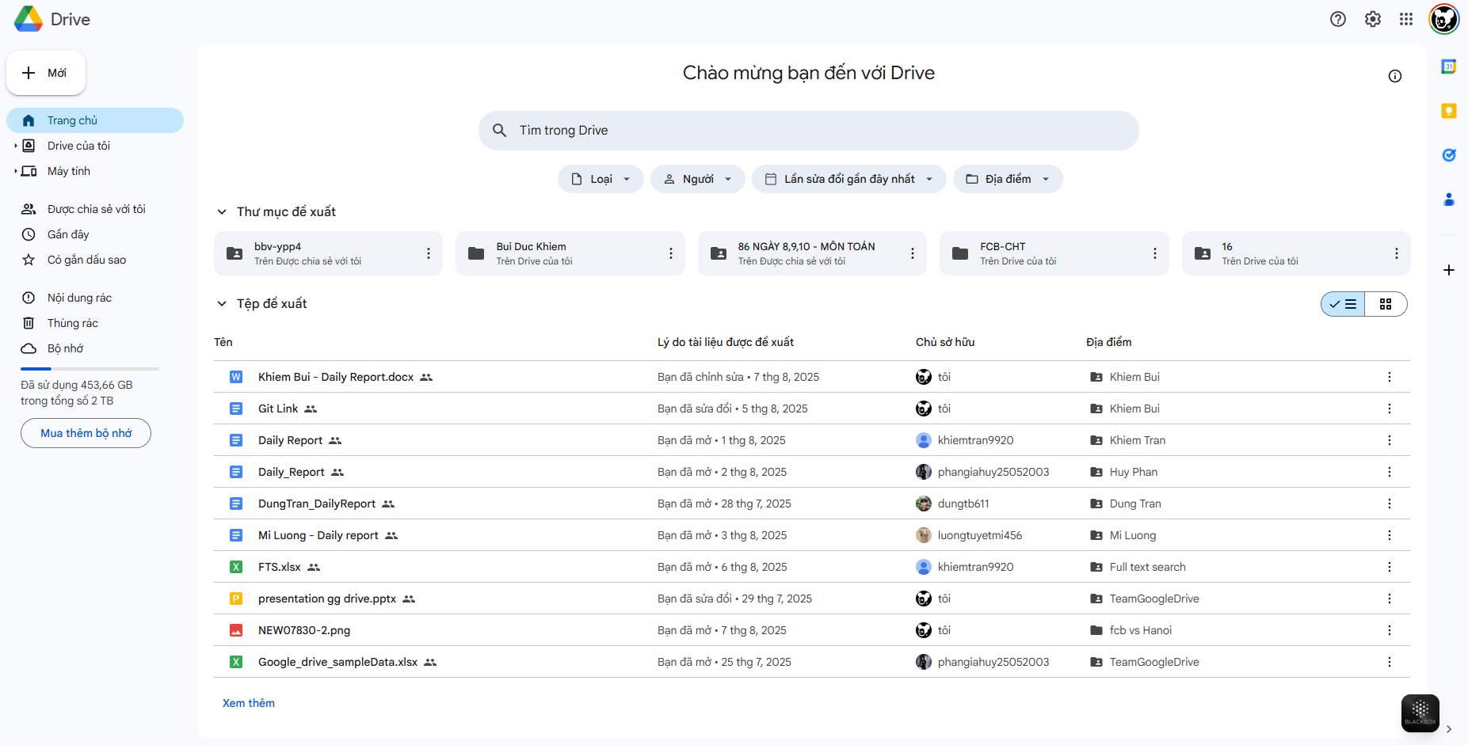
First Screen
Setting
SharedUser
ActionRecent
Account
Folder
UserViewSetting
ObjectType
E FavoriteObject
Trash
User Capacity
FileType
UserFile

Slide 5
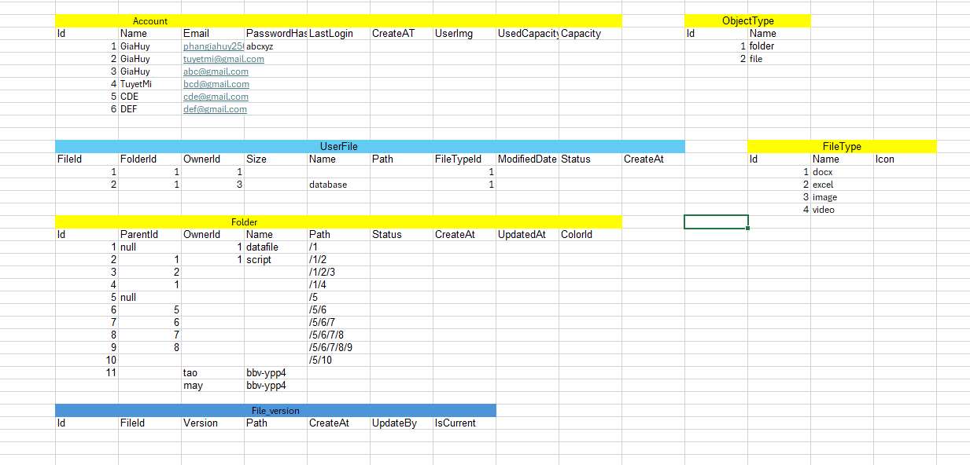
Sample Data

Slide 6
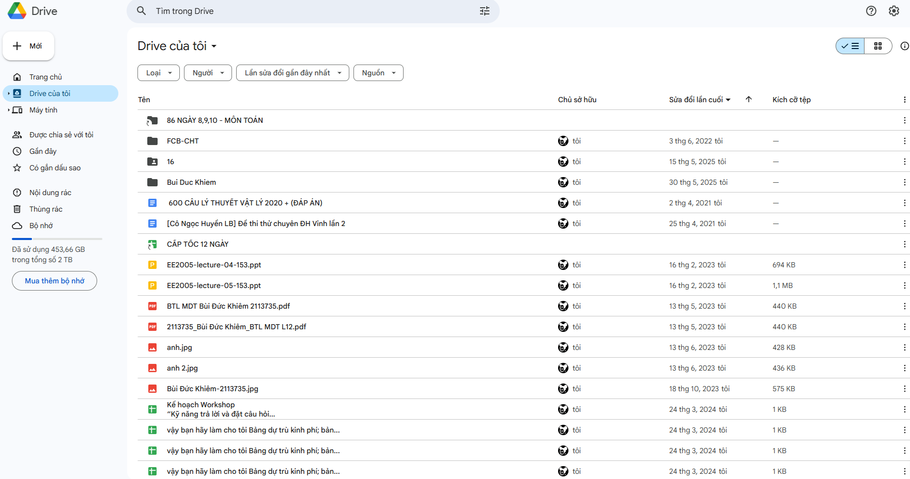
My drive
Select File/folder where user login is owner
Get folder
Get file
Notes:
SELECT login user file
DECLARE @LoginUser INT = 1
SELECT
uf.FileId,
a.UserName,
uf.UserFileName
FROM UserFile uf
JOIN Account a ON uf.OwnerId = a.UserId
WHERE a.UserId = @LoginUser
SELECT login user folder
DECLARE @userId INT = 1
SELECT
fo.FolderId,
a.UserName,
fo.FolderName
FROM Folder fo
JOIN Account a ON fo.OwnerId = a.UserId
WHERE a.UserId = @userId

Slide 7
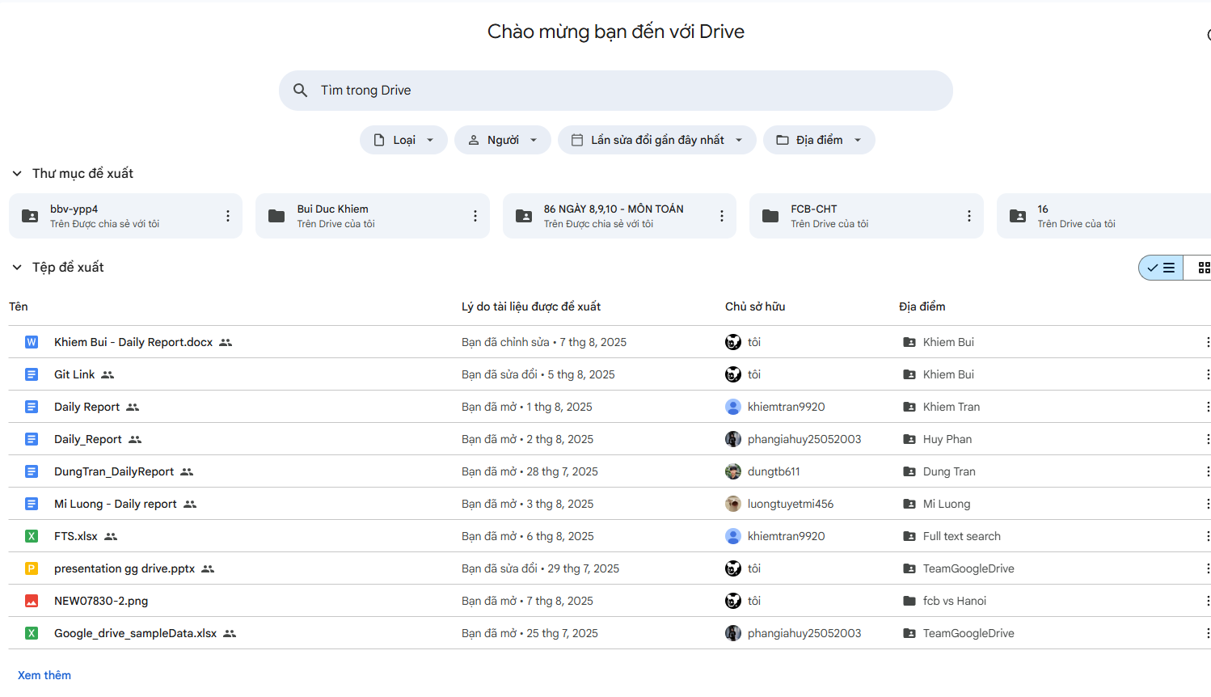
Recomment file/folder
Notes:
RECOMMENT folder
DECLARE @userId INT = 3
SELECT TOP 10
fo.FolderId,
a.UserName,
fo.FolderName,
ar.ActionLog,
ar.ActionDateTime
FROM ActionRecent ar
JOIN Account a ON ar.UserId = a.UserId
JOIN Folder fo ON ar.ObjectTypeId = 1 AND ar.ObjectId = fo.FolderId
WHERE ar.UserId = @userId
ORDER BY ar.ActionDateTime DESC
RECOMMENT file
DECLARE @userId INT = 2
SELECT TOP 10
f.FileId,
a.UserName,
f.UserFileName,
ar.ActionLog,
ar.ActionDateTime
FROM ActionRecent ar
JOIN Account a ON ar.UserId = a.UserId
JOIN UserFile f ON ar.ObjectTypeId = 2 AND ar.ObjectId = f.FileId
WHERE ar.UserId = @userId
ORDER BY ar.ActionDateTime DESC

Slide 8
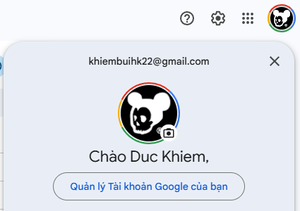
Account
Email
UserName
UserAvatar
Notes:
Select User Information
Declare @userId int = 1
select
a.UserName as UserName,
a.Email as Email
from Account a
where a.UserId =@userId

Slide 9
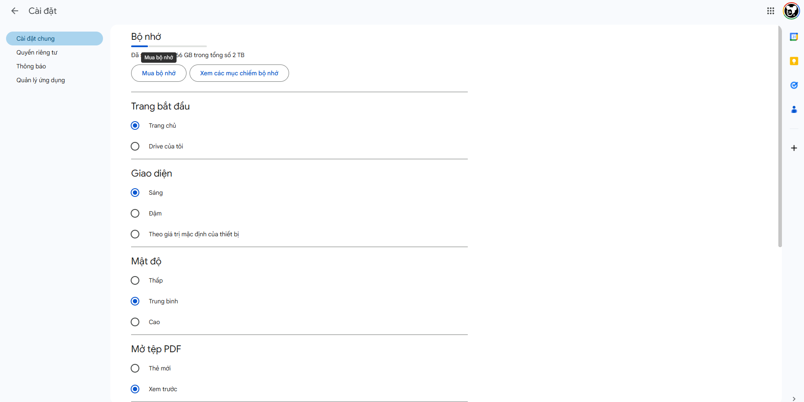
Setting
Setting of login Account
Settingkey
Settingvalue
Notes:
Select Login User Setting
DECLARE @userId INT = 1;
SELECT
su.SettingUserId,
a.UserName AS UserName,
s.SettingKey,
s.SettingValue
FROM SettingUser su
JOIN Account a ON su.UserId = a.UserId
JOIN AppSetting s ON su.SettingId = s.SettingId
WHERE a.UserId = @userId

Slide 11
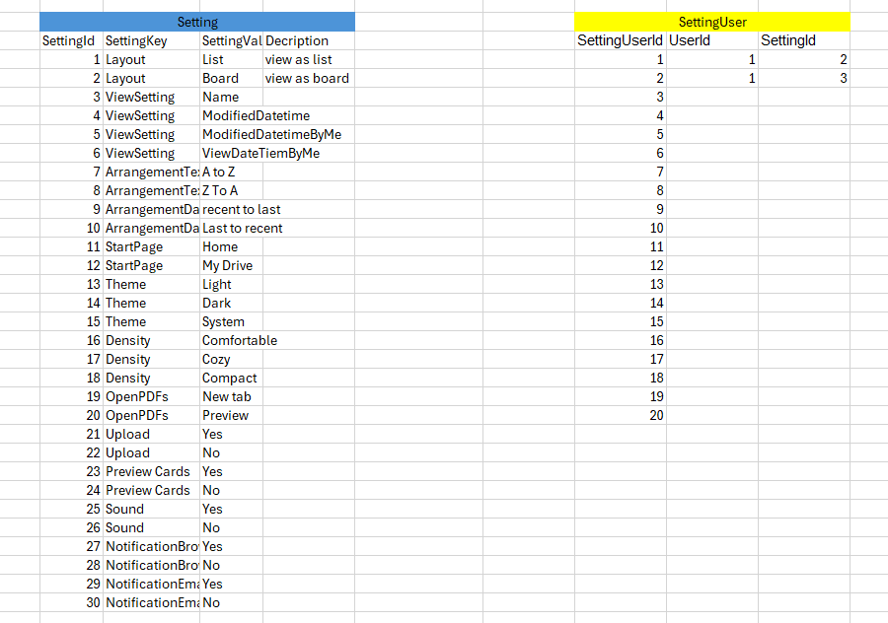
Setting Sample Data

Slide 12
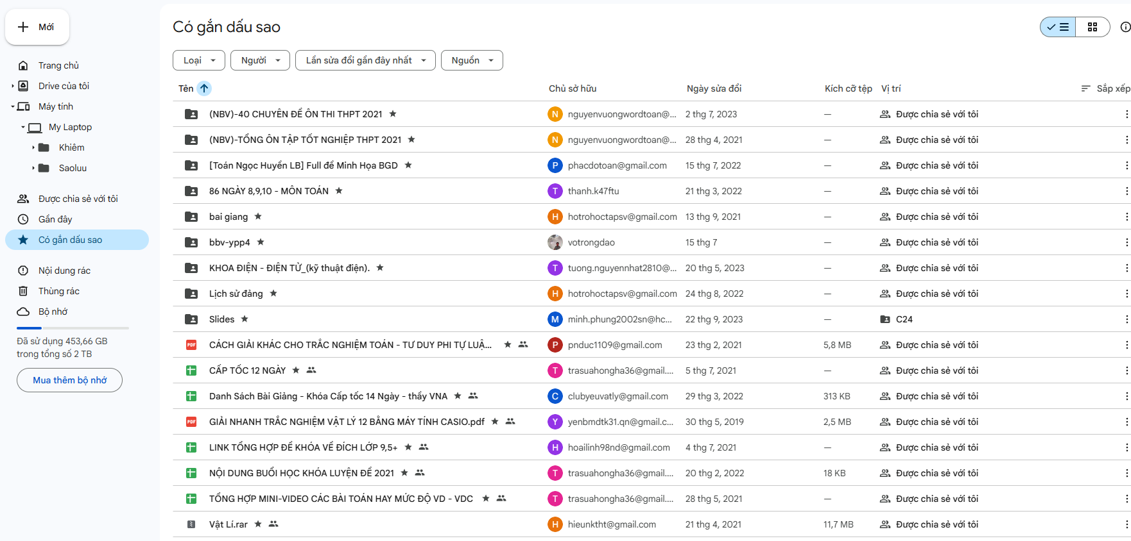
FavoriteObject
Notes:
Select stared file/folder of login user

Slide 13
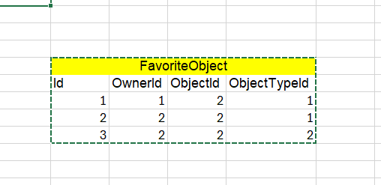
Sample Data FavoriteObject

Slide 14
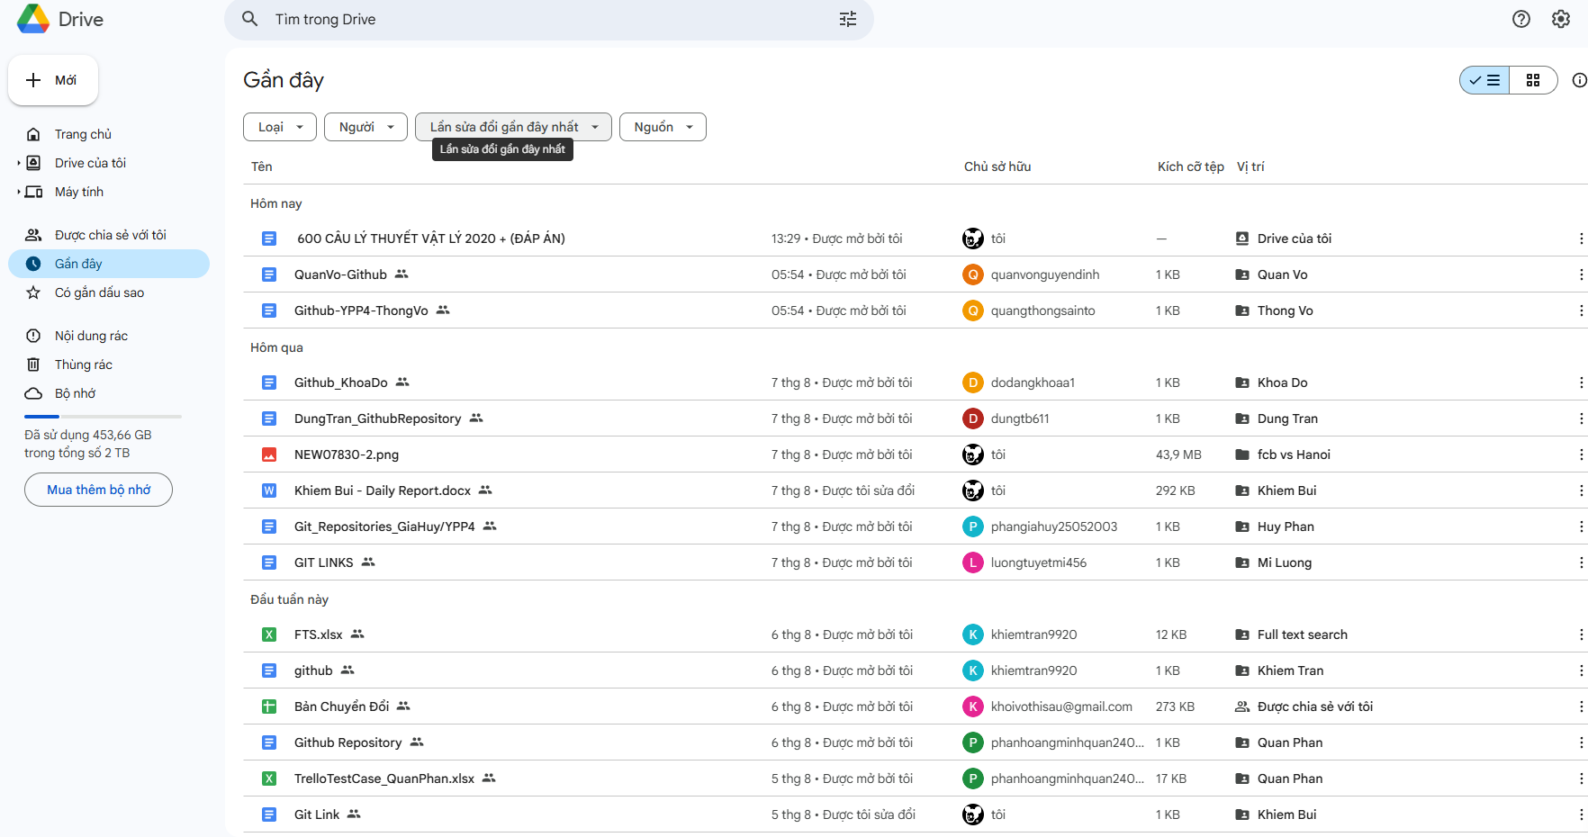
Recent action
Notes:
Select File/Folder which recent action
-- Sort by Action recent
WITH RecentObjects AS (
SELECT
ar.ObjectId,
ar.ObjectTypeId,
ar.ActionDateTime,
ar.ActionLog,
CASE
WHEN ar.ObjectTypeId = 1 THEN 'Folder'
WHEN ar.ObjectTypeId = 2 THEN 'File'
ELSE 'Unknown'
END AS ObjectType,
uf.OwnerId AS FileOwnerId,
f.OwnerId AS FolderOwnerId
FROM ActionRecent ar
LEFT JOIN UserFile uf ON ar.ObjectId = uf.FileId AND ar.ObjectTypeId = 2
LEFT JOIN Folder f ON ar.ObjectId = f.FolderId AND ar.ObjectTypeId = 1
WHERE (uf.OwnerId = 11 OR f.OwnerId = 11)
)
SELECT
ro.ObjectId,
ro.ObjectTypeId,
ro.ObjectType,
CASE
WHEN ro.ObjectType = N'File' THEN uf.UserFileName
WHEN ro.ObjectType = N'Folder' THEN f.FolderName
ELSE NULL
END AS ObjectName,
ro.ActionLog,
ro.ActionDateTime
FROM RecentObjects ro
LEFT JOIN UserFile uf ON ro.ObjectId = uf.FileId AND ro.ObjectTypeId = 2
LEFT JOIN Folder f ON ro.ObjectId = f.FolderId AND ro.ObjectTypeId = 1
WHERE ro.FileOwnerId = 11 OR ro.FolderOwnerId = 11
ORDER BY ro.ActionDateTime DESC;
SELECT * FROM ActionRecent
SELECT * FROM UserFile
SELECT * FROM Folder WHERE OwnerId = 11 AND FolderId = 37

Slide 15
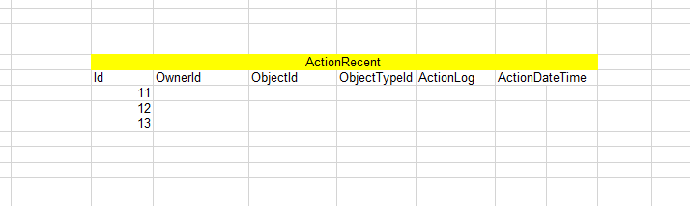
Sample Data ActionRecent

Slide 16
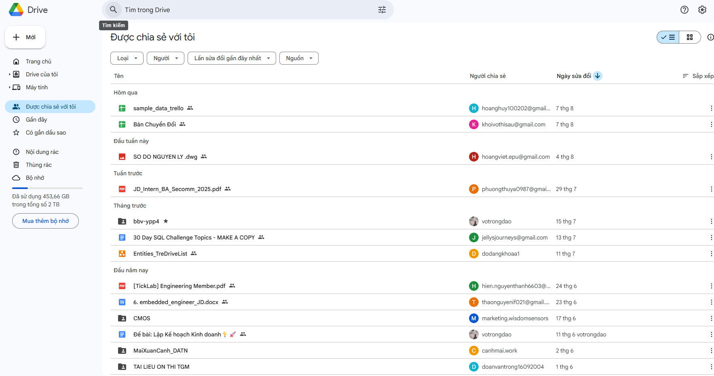
Share for login user
Sort by Filetype
Sort by Owner
Sort by ActionRecent
Notes:
Select File/Folder. Which have been shared to Login User
Sort by FileType
Sort by Owner
Sort by Action Recent

Slide 17
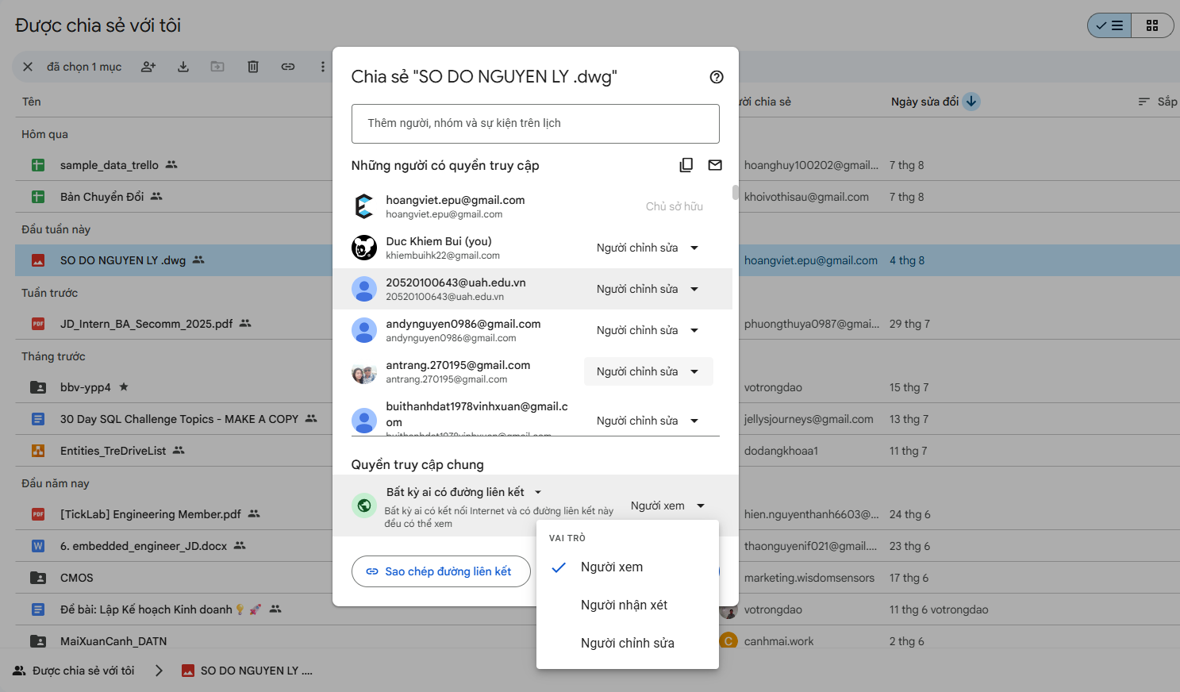
Share
Share
Permission

Slide 19
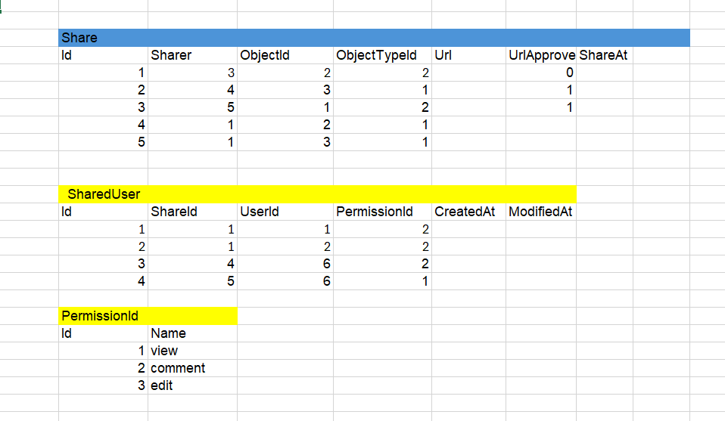
Sample Data Share

Slide 20
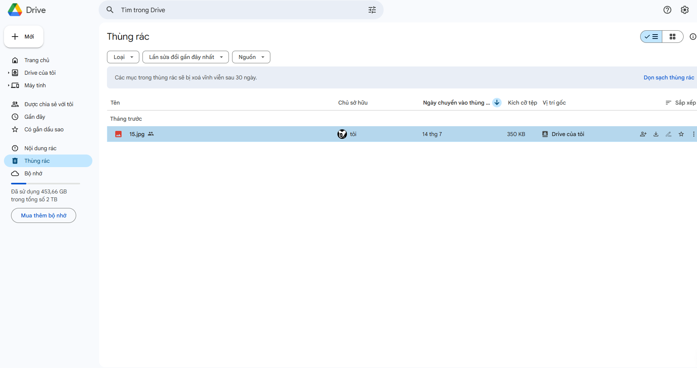
Trash
Select file/folder were deleted by login user
Notes:
Select file/folder were deleted by login user

Slide 22
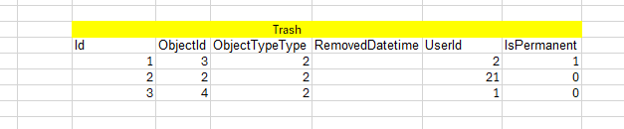
Sample Data Trash

Slide 23
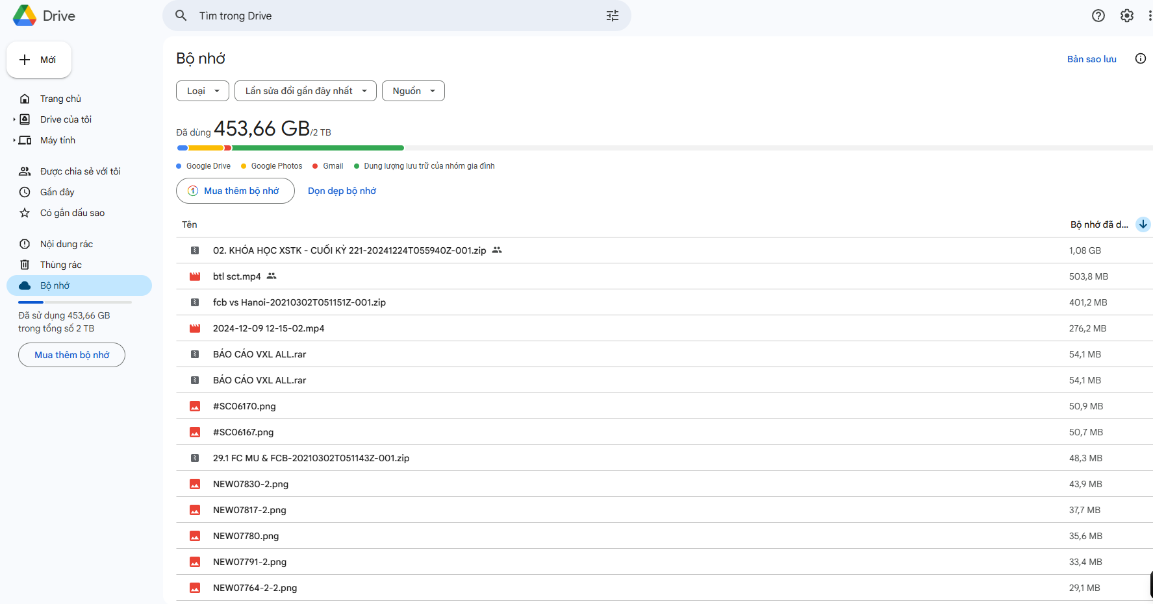
UserCapacity
Select login User capacity and UsedCapacity
Get list file by size

Slide 24
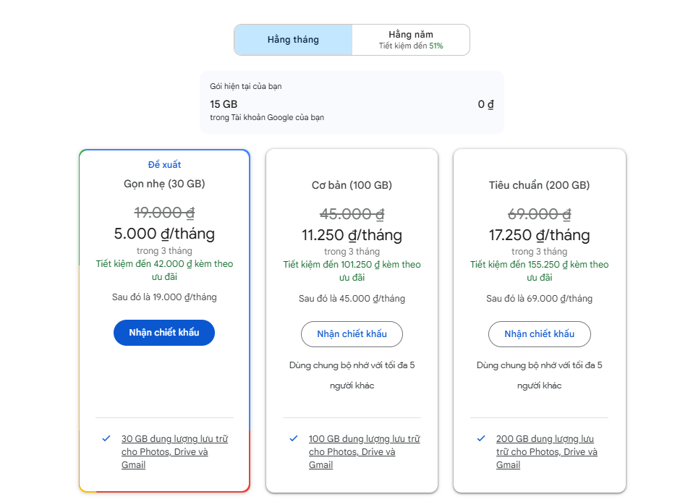
UserProduct
Duration
Product Item name
Select Product of login User
Select GoogleDrive’s Products
Promotion
Cost
Notes:
Select GoogleDrive’s Products
Select Product of login User

Slide 25
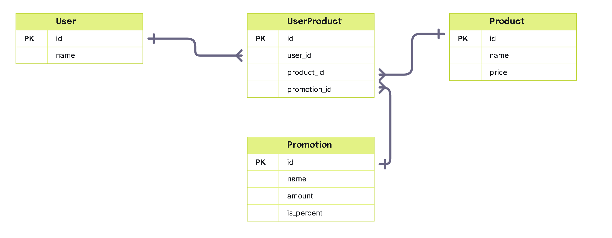
Table for Product Feature

Slide 26
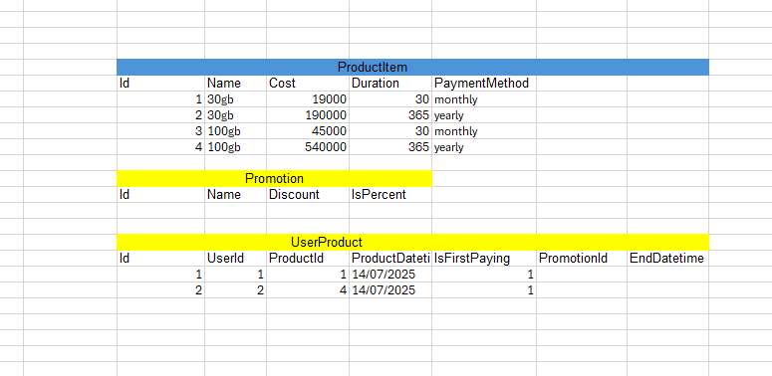
Sample Data Product

Slide 27
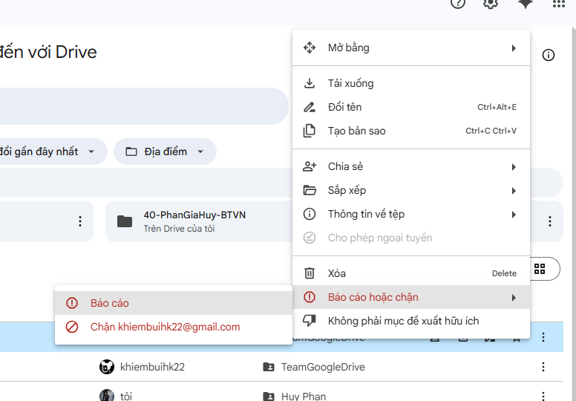
Banned
Select User have been Banned by login user

Slide 29
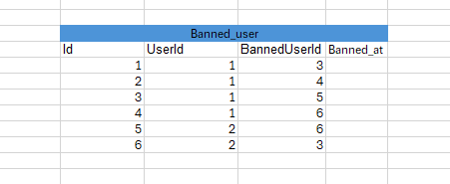
Sample Data Banned

